Slide 1
SAP BTP CLD500 Training
Day 3
Anubhav Oberoy
www.AnubhavTrainings.com
Follow excellence with sheer passion

Slide 2

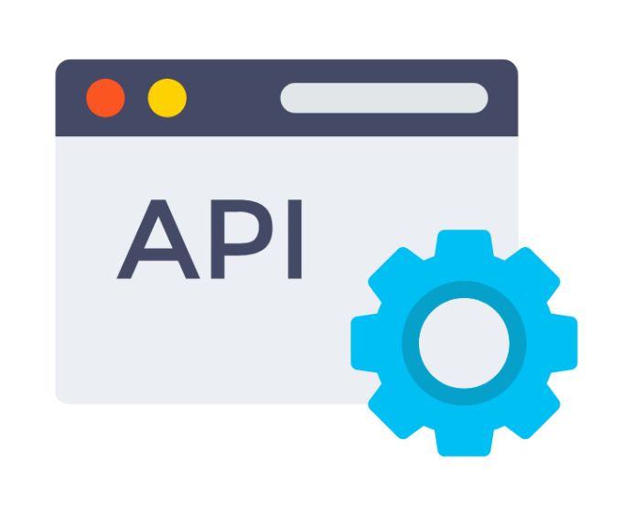
What is an API
API stands for Application Programming Interface, It is a end point, single point of contact for communication to data of a system and perform different kind of operations like create, read, update, delete, path, (CURDQ)
www.anubhavtrainings.com

Slide 3
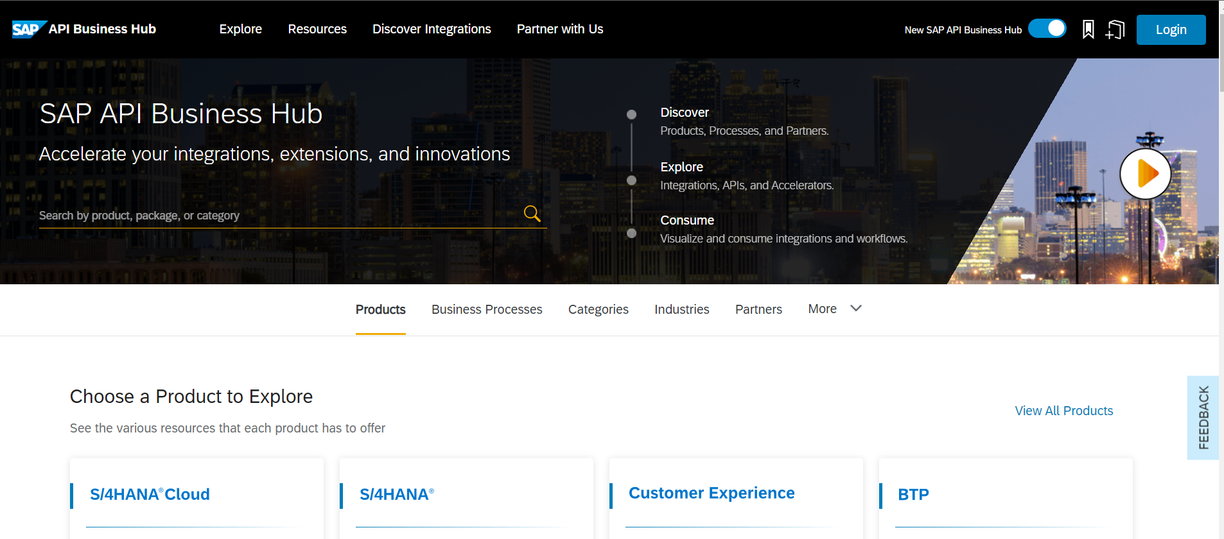
API HUB introduction
SAP Cloud Platform API management provides simple, scalable and secure access to digital assets through application programming interfaces (APIs) and enables developer communities to consume these. Key capabilities. Ÿ Unified standards-based API access of REST/OData or SOAP. services.
The SAP API Business Hub is a web application hosted by SAP to discover, explore, and test SAP and partner APIs (application programming interfaces) that are required to build extensions or process integrations. It also hosts Integration content, Events, CDS views, and more.
www.anubhavtrainings.com

Slide 4
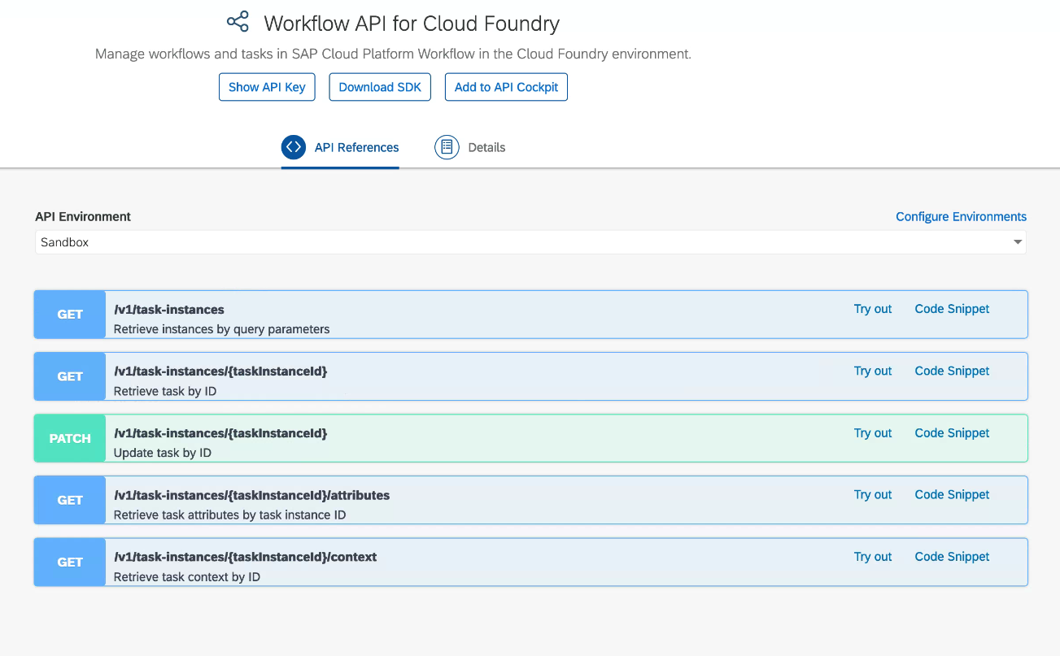
Build Process Automation API
The workflow API documentation helps us understanding the end points and sample payload to integrate cloud workflows with third-party and native SAP solutions. It describes the different aspects that the API covers, such as:
User Task Instances
Workflow Definitions
Workflow Instances
Forms
www.anubhavtrainings.com

Slide 5
Start workflow instance from API HUB Sandbox
We will first explore the service key generated out of our workflow deployment and then use properties here.
Specify the following values, noting that the Starting URL selection should reflect the value of the endpoints.workflow_rest_url property, including the particular region:
Property | Value
Starting URL | the value of endpoints.workflow_rest_url
Display Name for Environments | AnubhavAPISandbox
OAuth 2.0 Client Id | the value of uaa.clientid
OAuth 2.0 Secret | the value of uaa.clientsecret
consumersubdomain | the most significant hostname part of the fully qualified domain name value of uaa.url
landscapehost | the rest of the fully qualified domain name value of uaa.url, excluding the 'authentication' part
Apply this environment to all APIs in this package that are not yet configured | checked
Save this environment for future sessions | selected
the value of uaa.url is
https://757589e9.authentication.eu10.hana.ondemand.com
the value of "consumersubdomain" should be 898789e9trial
the value of "landscapehost" should be eu10.hana.ondemand.com
the resulting "Token URL" should be
https://757589e9trial.authentication.eu10.hana.ondemand.com/oauth/token
www.anubhavtrainings.com

Slide 6
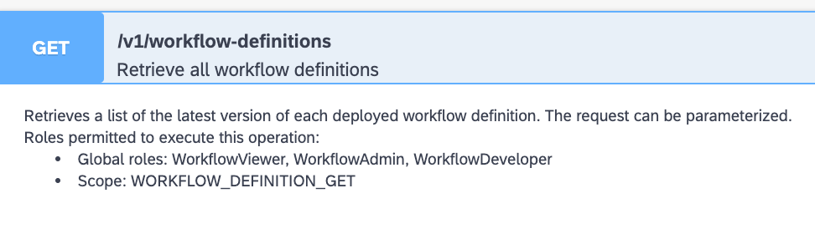
Understanding Security of Cloud Foundry APIs
For many services, API usage is protected by scopes, also known as authorities. These scopes are relevant when using an authenticated connection in the context of an OData 2.0 client credentials grant type.
In other words, authorities come into play (to "authorize" a call) when the authentication is connected directly to the instance. When an instance of a service is created, there may be some default scopes included, but it's always best to be explicit and specify the scopes that you'll require.
APIHUB (client) - POSTMAN
XSUAA
Workflow API
CF Workflow instances
Check authenticated
JWT token
Check scope
Read workflow instances/start/stop…
www.anubhavtrainings.com

Slide 7
Inject and Test scope
Since an instance of workflow service was created as part of a larger process, like in the booster case in an earlier exercise, you can update the service instance and add the scopes manually.
Check cf target if we already login to cloud foundry or not, if not use cf login
Find the list of all the services cf services
Issue command to inject the scope to workflow service
cf update-service sap_processautomation -c '{"authorities": ["ProcessAutomationAdmin"]}'
The value supplied with the -c command option is in JSON format, make sure you use the right combination of quotes and brackets. Happily, as we're all using a Linux based Bash shell courtesy of the App Studio, there are no variations to worry about here!
5. Test the APIs again from API HUB
GET /v1/workflow-definitions
POST /v1/workflow-instances
{
"definitionId": "orderprocess",
"context": {
"request": {
"Id": "HT-1002",
"Quantity": 42
}
}
}
www.anubhavtrainings.com

Slide 8
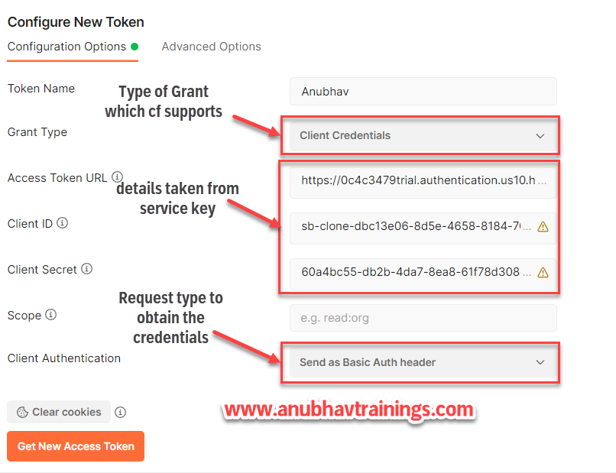
Calling the API from Postman with Bearer
www.anubhavtrainings.com

Slide 9
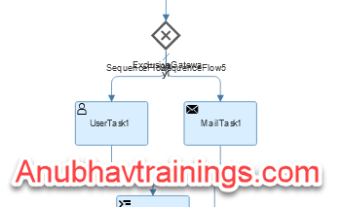
Gateways in workflow
A gateway controls the flow of execution and is represented visually as a diamond shape with an icon inside. The icon shows the type of gateway.
The workflow capability editor supports the following gateway types:
● Exclusive gateway: Use an exclusive gateway to model a decision in the process. When the execution arrives at this gateway, all outgoing sequence flows are evaluated in the order in which they’re defined. The sequence flow with a condition that evaluates to true is selected to continue the process.
If multiple sequence flows have a condition that evaluates to true, the first one defined is selected to continue the process. If none of the conditions defined for the sequence flow evaluate to true, then the one marked as default flow is selected and the execution proceeds along that path.
www.anubhavtrainings.com

Slide 10
Gateways in Workflow
●Parallel gateway: Use a parallel gateway to split into multiple paths of execution or merge multiple incoming paths of execution. The functionality of the parallel gateway is based on the following incoming and outgoing sequence flow:
Split: All outgoing sequence flows are executed in parallel; there’s one concurrent execution for each sequence flow.
Join: All concurrent executions arriving at the parallel gateway wait in the gateway until an execution has arrived for each incoming sequence flow. Then the process continues past the joining gateway.
A parallel gateway works on a logical level. It doesn’t speed up the technical execution.
For example, consider a scenario where an employee approaches the travel desk to book a flight and accommodation for a business trip. With a parallel gateway, both the flight arrangement and the hotel accommodation can happen in parallel. Once the booking is successful, an e-mail notification can be sent to the employee.
www.anubhavtrainings.com

Slide 11
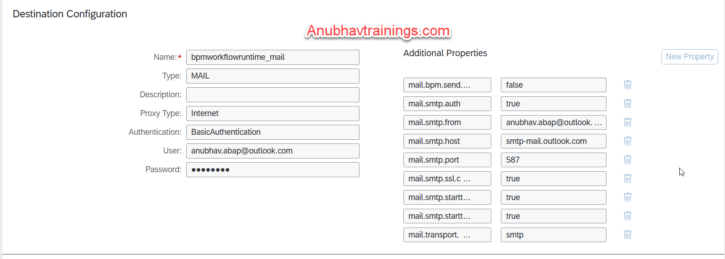
Configure Email
Before you can send notification mails for mail tasks within a workflow, you must first configure a mail destination.
Refer the documentation as below for destination creation
https://help.sap.com/docs/WORKFLOW/f85276c5069a429fa37d1cd352785c25/a24a9482314344f780e48f3195597cb2.html
www.anubhavtrainings.com
Notes:
https://help.sap.com/docs/WORKFLOW/f85276c5069a429fa37d1cd352785c25/a24a9482314344f780e48f3195597cb2.html

Slide 12

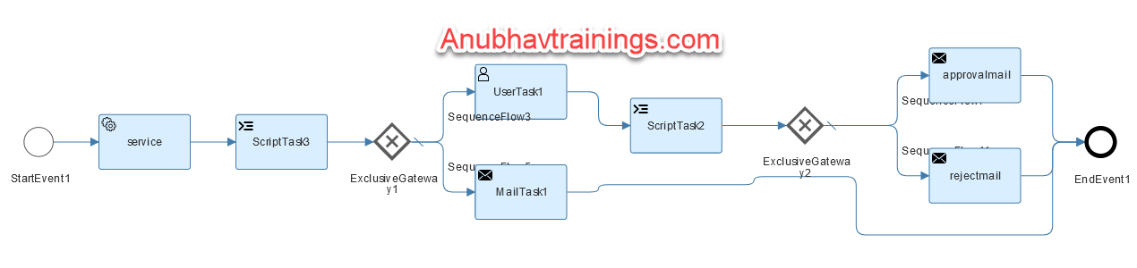
Workflow Use Case 3
Alex is a manager working in one of the top IT Company. He is being approached for every shopping cart request created by employees reporting to him. His key requirements are
Design a workflow to automate the shopping cart for products
He want an approval only if the product cost is above 100 USD
If the product cost is less than 100 USD the shopping cart should approve automatically
On approval (or auto-approval) or rejection, an email should trigger to creator
If Alex do not take action on shopping cart request for more than 5 minutes, we should cancel the workflow
Cheat sheet workflow expressions
https://help.sap.com/docs/WORKFLOW/e157c391253b4ecd93647bf232d18a83/9f91b1c0fac3414d9cba1015dea381f1.html
www.anubhavtrainings.com
Notes:
/sap/opu/odata/sap/EPM_REF_APPS_SHOP_SRV/Products('${context.id}')?$format=json
$.context.val = parseInt($.context.response.d.Price);
if(parseInt($.context.response.d.Price) > 100){
$.context.status = true;
}else{
$.context.status = false;
}
var lastUserTask1 = $.usertasks.usertask1.last;
$.context.subject = lastUserTask1.subject;
$.context.processor = lastUserTask1.processor;
$.context.doneOn = lastUserTask1.completedAt;
$.context.status = lastUserTask1.decision;
${context.status == true}
${context.status == "approve"}
{
"id": "HT-1000",
"response": ""
}

Slide 13
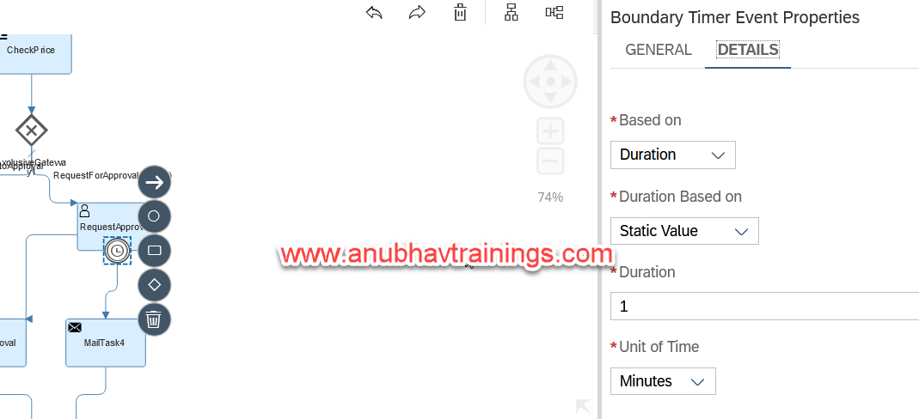
What is deadline monitoring
When we design workflow user tasks, sometimes we would like to cancel the tasks automatically if the user does not take action onto it within given time limit. We can use Boundary timer event to cancel the tasks in such cases.
www.anubhavtrainings.com

Slide 14
Enhance mail body using HTML
If we would like to give special design/template to our mail body which is used in the mail task, we can configure HTML body in the workflow steps.
Here is a helpful website to design HTML body
https://wordtohtml.net/
www.anubhavtrainings.com

Slide 15

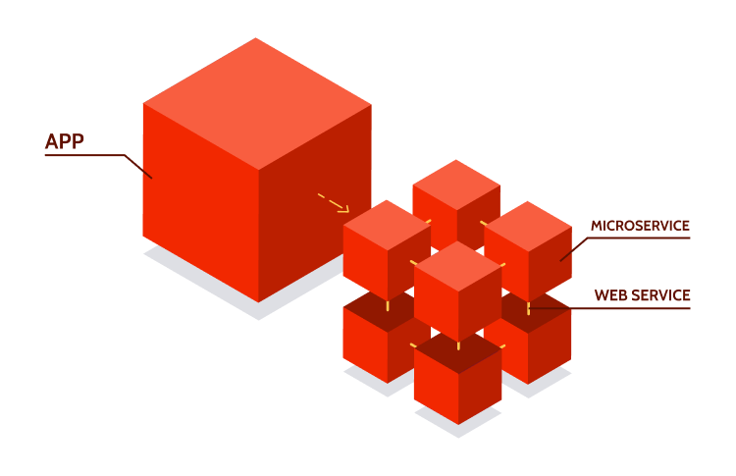
Core Concepts – UI5, Microservice
What is SAP UI5
SAP UI5 is a framework to develop responsive web applications which can run on any device, any platform and any
browser. It is SAP’s latest UI technology to build Fiori (user experience) applications.
We can develop an SAP UI5 project with Business application studio. The main aspects are
Component.js – a starting file for launching and initializing our app
View – the application user interface to display controls to the user – coded in XML
Controller – Where we write all processing logic
Model – the data related to the application
Join us on end to end ui5 development course at Anubhav Trainings
What is Microservice Architecture
When we use SAP BTP Cloud foundry environment, all the deployed applications are realized as microservices. For example, if we create a workflow, it is one microservice at runtime. Similarly a SAP UI5 application is also created as a microservice. These micro-services consumes backing services of cloud foundry environment to run.
www.anubhavtrainings.com

Slide 16
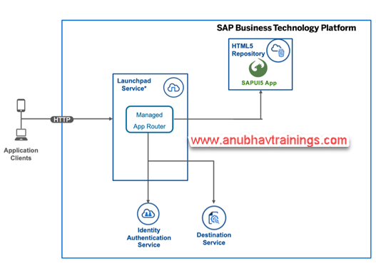
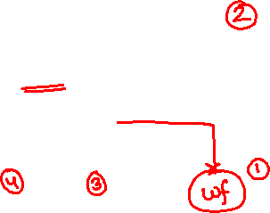
Core Concepts – HTML5 Repo, App Router
HTML5 application repository enables central storage of HTML5 applications' static content on the SAP BTP, Cloud Foundry environment. This service can be consumed from the SAP BTP, Cloud Foundry Runtime. HTML5 applications consist of static content such as HTML, CSS, JavaScript, and other files, that run on a browser. HTML5 application repository allows application developers to manage the lifecycle of their HTML5 applications. In runtime, the repository enables the consuming application, typically the application router, to access HTML5 application static content in a secure and efficient manner.
Managed App Router
The managed application router enables you to access and run HTML5 applications in a cloud environment without the need to maintain your own runtime infrastructure.
The managed application router is the HTML5 applications runtime capability
SAP Launchpad service
To use the managed application router, you must be subscribed to one of these services.
www.anubhavtrainings.com

Slide 17
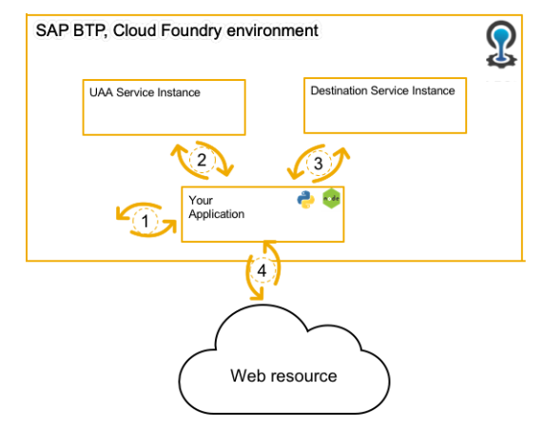
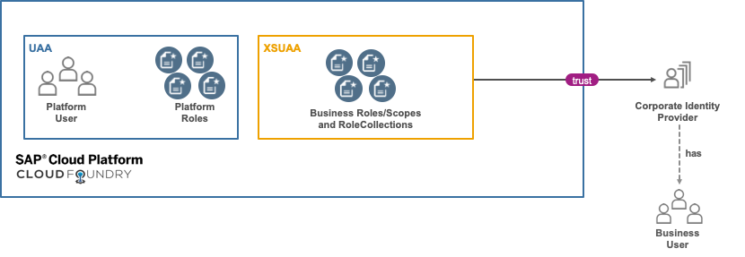
Core Concepts – Destination Service, XSUAA
Destination Service
Destination service REST API specification for the SAP Cloud Foundry environment.
The Destination service provides a REST API that you can use to read and manage destinations and certificates on all available levels.
The service is helpful for
Never ever (ever!) add sensitive information, such as passwords, to your code!
Authentication strategies vary access different destinations types and you need to implement each single one
Dev tools (like code generators) have virtually no use if they cannot access supporting information
XSUAA Service
The XSUAA is one of the most important component to deal with when developing your own applications on Cloud Foundry. It takes care to authenticate and authorize your business users and assign the right principals to your user’s session so your application can:
Identity the user by Email, UserId, First and Lastname
Check his roles (scopes) to decide if a user is allowed to do something or prohibit is action
www.anubhavtrainings.com

Slide 18
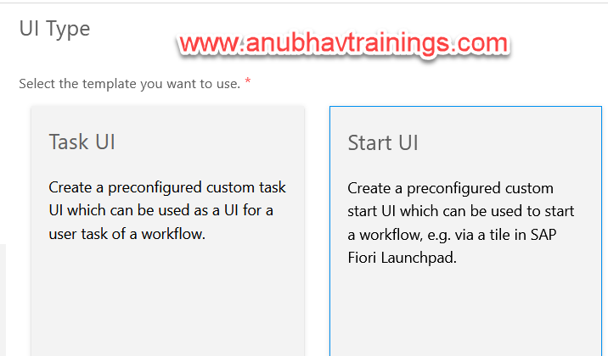
Adding custom UIs for Workflow
With the REST-based APIs of the workflow capability, you can access the workflow capability runtime. On top of these APIs, you can develop scenario-specific user interfaces for user tasks or workflow start UIs.
Custom Start UI
With SAPUI5, this option gives you a high level of control over the UI.
Custom Task UI
This option enables you to create a simple, straightforward UI using predefined elements.
www.anubhavtrainings.com

Slide 19

Use case scenario 4
Sofia is working as a lead manager in one of the outsourcing company. She help IT companies to find right talent and send them to offshore project. She want us to design a workflow, which when started request for following candidate details
Name, Work Experience (number), Previous/Current Employer name, Skills (ABAP, UI5, BTP, S/4HANA), Country for travel, and budget (in USD)
Once the details are filled, a work item needs to be sent to HR specialist to review details and approve/reject the budget.
www.anubhavtrainings.com

Slide 20
Adding Managed App Router
As mentioned before, the managed app router will be responsible to communicate between our UI5 module and our workflow API. Since the app router also usage the XSUAA service, it will only allow authenticated calls to direct to our application.
Managed App Router (usage xs-app.json)
HTML5 Repository
XSUAA Service
xs-security.json
Destination Service
Workflow
Security and Authorization control
Workflow UIs
This will be used to authenticate our application via xsuaa while calling Workflow APIs.
Cf dest
Communicate to workflow API
www.anubhavtrainings.com

Slide 21
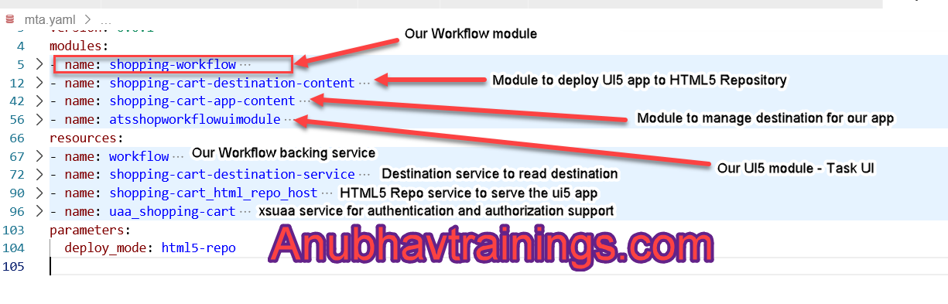
Adding UI5 Component – Task UI
Once we finished adding task ui component, a new UI5 module gets added along with configuration in mta.yaml file. The mta file below explains the purpose of each component and backing services added to the multi target application.
www.anubhavtrainings.com

Slide 22
Task Model and Workflow API Integration
My Inbox passes the additional data to a custom task UI through the SAPUI5 component’s startup parameters.
The task model contains data related to user tasks.
The taskModel is of type sap.ui.model.json.JSONModel and contains the following task properties:
https://help.sap.com/docs/WORKFLOW/e157c391253b4ecd93647bf232d18a83/735e9ff312dc4b8c838093a1e245518f.html?q=getInboxAPI
You can add task completion buttons to My Inbox, control the visibility of the footer bar or the back navigation button, and more with the My Inbox UI Integration API.
www.anubhavtrainings.com

Slide 23
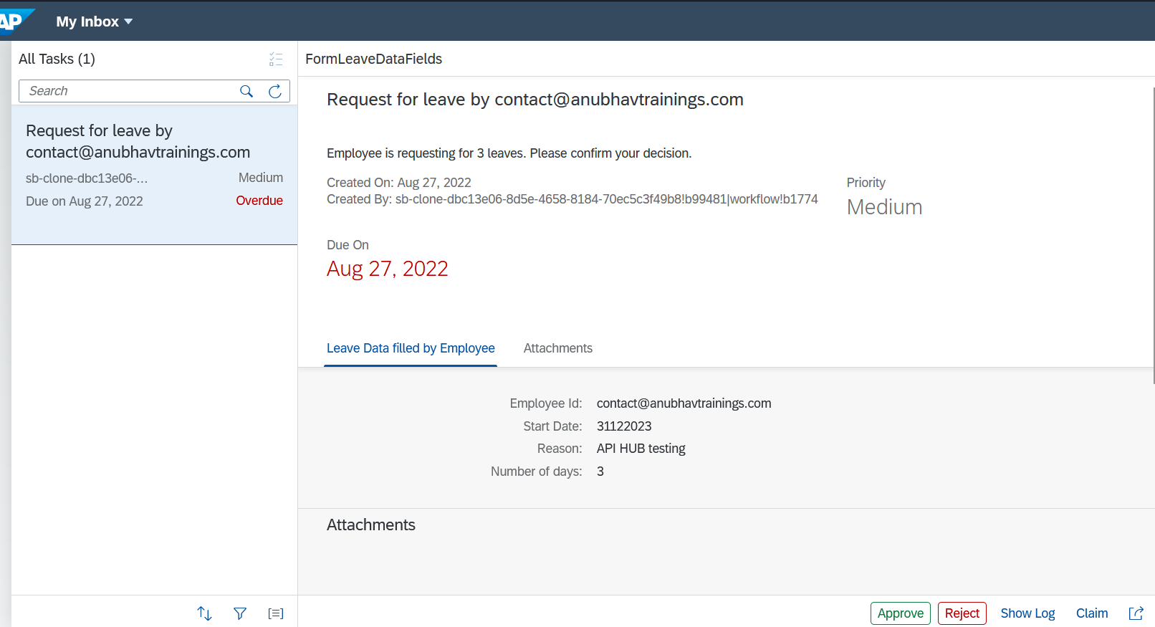
Behind the scenes
Content
www.anubhavtrainings.com

Slide 24
Working with Custom Start UI
A user interface is needed which would allow end users to start the instances of the corresponding workflow. In addition, the users must be able to specify some arbitrary values that will be used in the contexts of the started instances.
You can either define the start UI using an HTML5 application (custom start UI).
"crossNavigation": {
"inbounds": {
"myworkflowapps": {
"semanticObject": "app",
"action": "open",
"title": "My Title",
"subTitle": "My Subtitle"
}
}
}
www.anubhavtrainings.com

Slide 25
What is Sub-flow
Inside one workflow, you can execute another workflow called a referenced sub-flow. You can configure the activity that you use to call the sub-flow. The sub-flow is an external workflow definition that can be reused and is deployed independently from the main workflow.
The main workflow stores data in the workflow context. You can pass a subset of this data to the sub-flow by configuring data mapping.
The sub-flow can modify the data and then return the data back into the main workflow using data mapping. The data is copied into the sub-flow when it is started and copied back into the main workflow when the sub-flow ends.
The main workflow calls the subflow and waits until the subflow ends before it continues with the next item. The workflow definition of the subflow is resolved at runtime. This means that the subflow can be deployed independently of the main workflow that is calling the subflow.
The subflow can be a workflow from the same project as the main workflow, or it can be any workflow that is deployed on the server.
www.anubhavtrainings.com

Slide 26
Parallel Sub-flow Elements
We can execute multiple instances of the referenced subflow in parallel, For this purpose, we need to create an array element in main workflow and pass that multi-line element to the sub workflow.
System will automatically create n number of instances of sub workflow based on number of items in the json collection. In the input and output mappings of the subflow, you can refer to individual items in the collection by using the loop.counter variable, for example, ${context.items[loop.counter].status}.
Optionally, We can specify a Completion Condition which If this condition evaluates to true while a single instance of the parallel subflow is completed, the parallel execution is considered completed as well. All other parallel instances are canceled. Output mappings for such canceled instances are skipped.
The mapping is used to transfer data between the main workflow and the subflow.
www.anubhavtrainings.com

Slide 27

Scenario use case 5
When a new employee in on-boarded to the company, we need to order multiple equipment for that employee like Mouse, Notebook, Head-phone, Keyboard, ID Card, and iPhone.
We would like to create a workflow, which can receive multiple products as input and trigger previously created shopping-cart workflow to automate mass order or shopping items.
www.anubhavtrainings.com

Slide 28
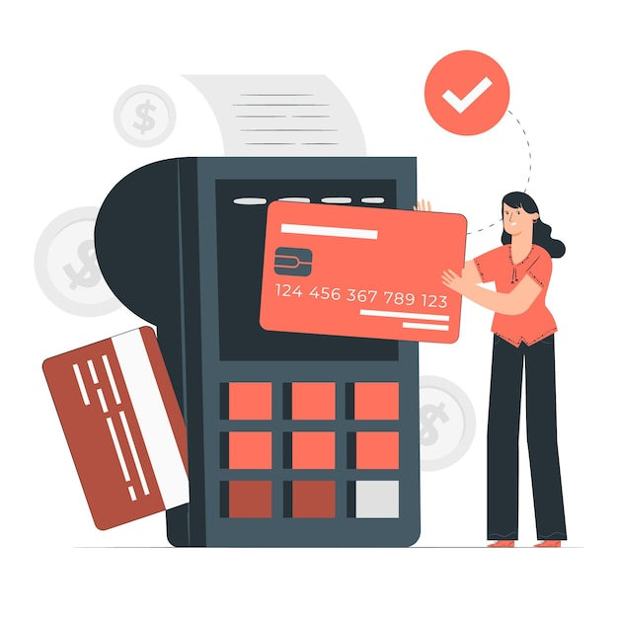
Workflow Scenario 6 E01 – Rule Service
Our company want to on-board new employees in the organization, while on-boarding employee, he/she will be provided a credit card along with credit limit. The type of credit card which will be provided, depends on the level of employee.
The below table describe the business condition
We want to design workflow which can automatically determinate the card type which can be issued to employee based on band(level) and trigger email for approval to employee whenever new employee is created.
Level of Employee | Issuance Card Type
T1 | Silver
T2 | Gold
T3 | Platinum
www.anubhavtrainings.com

Slide 29
What is Business Rule and Why?
A business rule defines or constrains some aspect of business. Business rules are intended to assert business structure or to control or influence the behavior of the business. Business rules describe the operations, definitions and constraints that apply to an organization. Business rules can apply to people, processes, corporate behavior and computing systems in an organization, and are put in place to help the organization achieve its goals.
Effective business rules help set expectations and provide guidelines on how work will be conducted. Business rules must also be used to ensure an organization abides by local, state, and federal regulatory requirements and guidelines.
Examples of Business Rules
A decision-making hierarchy for invoice processing, where the values of specific invoices are tiered to determine which managers can approve.
Calculations to determine bonus potential and payouts for sales personnel.
A series of required questions that if an answer is no, a specific vendor is excluded from a particular partnership opportunity.
A set of questions and answers for a guest booking a hotel room to determine availability and rates.
www.anubhavtrainings.com

Slide 30
Why we need a Business Rule Management
application
Credit score
Accept/Reject
Loan is disbursed
Rules
Lifestyle
Job
Salary
Bonus
Other loan
Investment
PF saving
Interest rate
BRMS
System
Model
www.anubhavtrainings.com

Slide 31
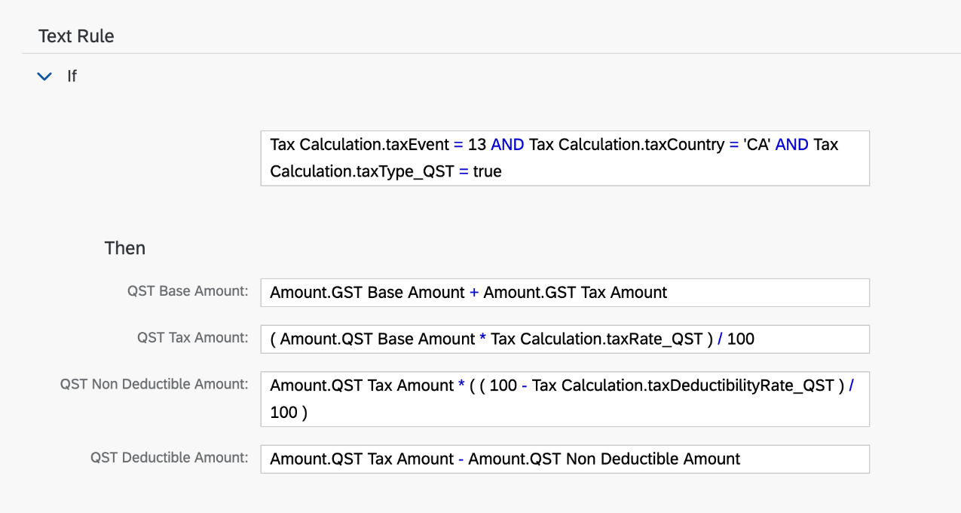
SAP BTP Rule Service
The business rules capability within the SAP Workflow Management service lets you digitize and automate decision making. It encapsulates dynamic decision logic from application logic. It also provides web-based tools to model business vocabulary and decision interfaces to integrate with SaaS applications and business services.
Manage the lifecycle of business rule projects across business systems using a central repository. Deploy rule services to multiple runtime environments like SAP BTP rule runtime, SAP S/4HANA Cloud, SAP S/4HANA or SAP HANA.
www.anubhavtrainings.com

Slide 32
Develop Rule in BTP
From the broad workflow requirement, we have identified that each employee which is on-boarded have different level (Band) in the organization, the credit card which can be issued to the employee depends on this rule (shown in table below).
The rule subjected to change in future also, hence we need to model the rule separately out of workflow. This way we achieve a decoupling of changing business needs and avoid deploying our workflow again and again.
Level of Employee | Issuance Card Type
T1 | Silver
T2 | Gold
T3 | Platinum
www.anubhavtrainings.com

Slide 33
Test Rule execution using APIHUB
Get Projects
https://<REPOSITORY_URL>/rules-service/rest/v1/projects
Get Project Services
https://<REPOSITORY_URL>/rules-service/rest/v1/projects/<projectid>/ruleservices
Test Business Rule from POSTMAN (POST)
https://<RUNTIME URL>/rules-service/rest/v2/workingset-rule-services
{
"RuleServiceId": "",
"Vocabulary": [
{
"Level": “<value>"
}
]
}
www.anubhavtrainings.com

Slide 34
Workflow Scenario 6 E02 – Consume Rule Service
Our company want to on-board new employees in the organization, while on-boarding employee, he/she will be provided a credit card along with credit limit. The type of credit card which will be provided, depends on the level of employee.
The below table describe the business condition
We want to design workflow which can automatically determinate the card type which can be issued to employee based on band(level) and trigger email for approval to employee whenever new employee is created.
Level of Employee | Issuance Card Type
T1 | Silver
T2 | Gold
T3 | Platinum
www.anubhavtrainings.com

Slide 35
Challenges sharing Projects
As of now one developer is sharing project code with another developers using zip file, if we have a development team of 20 developer, we will have 20 zip files coming in email box, how easy it is for someone to merge these zip files to have a final ready code for customer?
Last night I was working and I slept with stable code, this morning I had fight with my girlfriend and I come to office. I made n number of changes to my code and destabilized it. Is there any way today to rollback your changes to last stable state? Basically, today as of now, there is no version control.
Many developers are working in different shifts and making changes to the source code, it is nightmare for someone to be available 24X7 to sync their changes. In fact, at times, there will be same line of code changed by more than 2 developers in their own environment.
When a developer does mistake which cause unstable code, we don’t know whom to blame.
A developer like Anubhav comfortable with VS Code but another developer Amelie is more comfortable with BAS, how can we easily switch development tools while developing Workflow apps.
Git and git hub
www.anubhavtrainings.com

Slide 36

Git HUB
Git HUB
Git HUB is worlds largest code repository on the internet. It stores trillions of projects of any technology.
Anubhav
Amile
git clone
BAS
Project
VS Code
git pull
Local git Repository
Local git Repository
First when a developer need project of already created git repository git clone URL this will create a local copy of project along with local repository
Stage change git add .
Commit this change locally git commit –m “”
Push change to remote git push
Initialize local git repo – git init
Avoid tracking node_modules – create a file .gitignore and add entry for node_modules
We need to tell git which are all files I want to track now – git add .
Now all files are added for tracking, We can create first stable version in git – git commit -m “message”
To go back to last stable state we can use the git reset --hard
Create a free git account on internet, we can now create a new git repo
A developer must create PAT token to perform work with git Developer Settings > PAT Token
*What is the remote branch name
git branch -M master
*Address of remote repository
git remote add origin <URL>
Push the code to remote repo from local repo
git push -u origin master
Remote Repository
gitHUB
www.anubhavtrainings.com

Slide 37
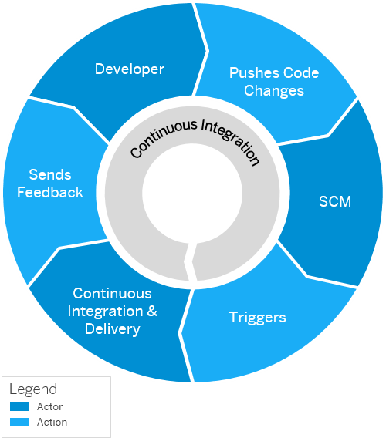
What is CI/CD
Continuous integration (CI) describes a software development process, in which various team members integrate their contributions frequently into a single main line. Before each integration, the changes are verified through builds and automated testing. Thereby, you can detect errors as quickly as possible and prevent integration problems before completing the development.
The continuous delivery (CD) concept expands on the one of continuous integration. It adds the aspect that any change that has successfully passed the tests is immediately ready to be deployed to production, both from a technical and a qualitative point of view.
www.anubhavtrainings.com

Slide 38
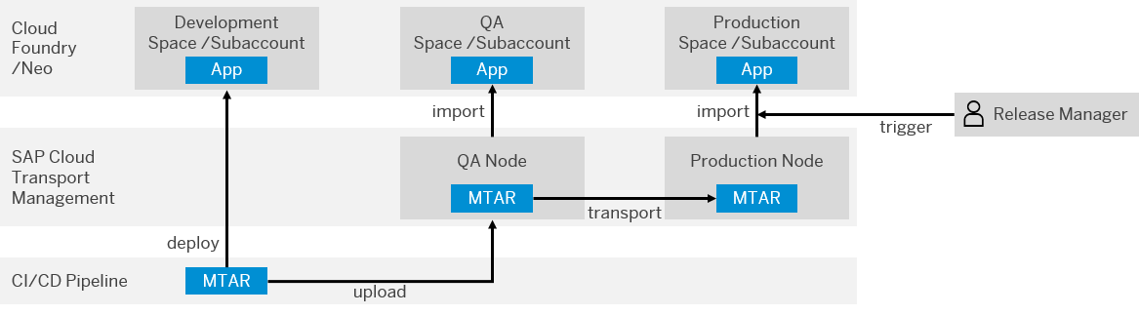
BTP CI/CD Management
www.anubhavtrainings.com

Slide 39
Title
Content
www.anubhavtrainings.com

Slide 40
Title
Content
www.anubhavtrainings.com

Slide 41
Title
Content
www.anubhavtrainings.com

Slide 42
Title
Content
www.anubhavtrainings.com

Slide 43

What We Did
Let’s Summarize

Slide 44

www.anubhavtrainings.com
Thank You
End of Day 3

Slide 45


We’re committed to empower you to be
#FutureReady
through powerful training solutions.
We build the workforce of the future.
250+
Corporate Clients
30,000+
Learners Trained
25000+
Learners Placed
FREE WEBINARS
Sign up for free webinars with industry experts every fortnight!
Enroll Now!
Contact us today!
https://anubhavtrainings.com

